Slide 1
CSCI 561 Foundations of Artificial Intelligence Lecture 2-4: Problem Solving & Search (Chapter 3)
Fall 2018
Instructor:
Prof. Sheila Tejada (stejada@usc.edu)

Slide 2
Outline: Problem solving and search
Introduction to Problem Solving
Problem Representation
Uninformed search
Search strategies: depth-first, breadth-first, uniform cost, variants
Informed search
Search strategies: best-first, A*
Heuristic functions

Slide 3
Example: Measuring problem!
9 l
5 l
3 l
Problem: Using these three buckets, measure 7 liters of water.

Slide 4
Example: Measuring problem!
(one possible) Solution:
a b c
0 0 0 start
3 0 0
0 0 3
3 0 3
0 0 6
3 0 6
0 3 6
3 3 6
1 5 6
0 5 7 goal
9 l
5 l
3 l
a
b
c

Slide 5
Example: Measuring problem!
(one possible) Solution:
a b c
0 0 0 start
3 0 0
0 0 3
3 0 3
0 0 6
3 0 6
0 3 6
3 3 6
1 5 6
0 5 7 goal
9 l
5 l
3 l
a
b
c

Slide 6
Example: Measuring problem!
(one possible) Solution:
a b c
0 0 0 start
3 0 0
0 0 3
3 0 3
0 0 6
3 0 6
0 3 6
3 3 6
1 5 6
0 5 7 goal
9 l
5 l
3 l
a
b
c

Slide 7
Example: Measuring problem!
(one possible) Solution:
a b c
0 0 0 start
3 0 0
0 0 3
3 0 3
0 0 6
3 0 6
0 3 6
3 3 6
1 5 6
0 5 7 goal
9 l
5 l
3 l
a
b
c

Slide 8
Example: Measuring problem!
(one possible) Solution:
a b c
0 0 0 start
3 0 0
0 0 3
3 0 3
0 0 6
3 0 6
0 3 6
3 3 6
1 5 6
0 5 7 goal
9 l
5 l
3 l
a
b
c

Slide 9
Example: Measuring problem!
(one possible) Solution:
a b c
0 0 0 start
3 0 0
0 0 3
3 0 3
0 0 6
3 0 6
0 3 6
3 3 6
1 5 6
0 5 7 goal
9 l
5 l
3 l
a
b
c

Slide 10
Example: Measuring problem!
(one possible) Solution:
a b c
0 0 0 start
3 0 0
0 0 3
3 0 3
0 0 6
3 0 6
0 3 6
3 3 6
1 5 6
0 5 7 goal
9 l
5 l
3 l
a
b
c

Slide 11
Example: Measuring problem!
(one possible) Solution:
a b c
0 0 0 start
3 0 0
0 0 3
3 0 3
0 0 6
3 0 6
0 3 6
3 3 6
1 5 6
0 5 7 goal
9 l
5 l
3 l
a
b
c

Slide 12
Example: Measuring problem!
(one possible) Solution:
a b c
0 0 0 start
3 0 0
0 0 3
3 0 3
0 0 6
3 0 6
0 3 6
3 3 6
1 5 6
0 5 7 goal
9 l
5 l
3 l
a
b
c

Slide 13
Example: Measuring problem!
(one possible) Solution:
a b c
0 0 0 start
3 0 0
0 0 3
3 0 3
0 0 6
3 0 6
0 3 6
3 3 6
1 5 6
0 5 7 goal
9 l
5 l
3 l
a
b
c

Slide 14
Example: Measuring problem!
Another Solution:
a b c
0 0 0 start
0 5 0
3 2 0
3 0 2
3 5 2
3 0 7 goal
3 0 6
0 3 6
3 3 6
1 5 6
0 5 7 goal
9 l
5 l
3 l
a
b
c

Slide 15
Example: Measuring problem!
Another Solution:
a b c
0 0 0 start
0 5 0
3 2 0
3 0 2
3 5 2
3 0 7 goal
3 0 6
0 3 6
3 3 6
1 5 6
0 5 7 goal
9 l
5 l
3 l
a
b
c

Slide 16
Example: Measuring problem!
Another Solution:
a b c
0 0 0 start
0 5 0
3 2 0
3 0 2
3 5 2
3 0 7 goal
3 0 6
0 3 6
3 3 6
1 5 6
0 5 7 goal
9 l
5 l
3 l
a
b
c

Slide 17
Example: Measuring problem!
Another Solution:
a b c
0 0 0 start
0 5 0
3 2 0
3 0 2
3 5 2
3 0 7 goal
3 0 6
0 3 6
3 3 6
1 5 6
0 5 7 goal
9 l
5 l
3 l
a
b
c

Slide 18
Example: Measuring problem!
Another Solution:
a b c
0 0 0 start
0 5 0
3 2 0
3 0 2
3 5 2
3 0 7 goal
3 0 6
0 3 6
3 3 6
1 5 6
0 5 7 goal
9 l
5 l
3 l
a
b
c

Slide 19
Which solution do we prefer?
Solution 1:
a b c
0 0 0 start
3 0 0
0 0 3
3 0 3
0 0 6
3 0 6
0 3 6
3 3 6
1 5 6
0 5 7 goal
Solution 2:
a b c
0 0 0 start
0 5 0
3 2 0
3 0 2
3 5 2
3 0 7 goal

Slide 20
Problem Solving in AI
Formulating a goal
Having 7 liters in bucket C
Winning a game of chess
Getting to a particular location
Saving people from a burning building
Getting an A in this course
Then searching for actions that will move toward goal
Search may take on a variety of formulations
Find any state that matches goal
Find all states that match goal
Prove that no state matches goal
Find best state that matches goal
Find best path to a goal state

Slide 21
Formalizing Problems

Slide 22
More on Goals, States, & Actions: Problem Formulation
Given a goal (e.g. drive from Arad to Bucharest) need to formulate the problem so we can search:
Problem definition:
The initial state: In(Arad)
Possible actions available in a given state: {Go(Sibiu), Go(Timisoara), Go(Zerind)}
Transition model: What each action does: RESULT(In(Arad),Go(Zerind)) = In(Zerind)
Goal test: {In(Bucharest)}
Path cost: mileage between cities traversed

Slide 23
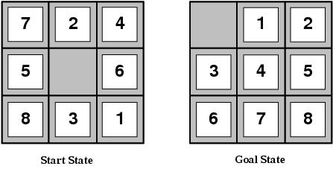
Eight Puzzle
Initial State: A configuration of Tiles
Actions: Slide a tile into space, or “move” space Left, Right, Up, Down
Transition model: returns resulting state from action
Goal State: Another configuration
Path cost: each tile move costs 1

Slide 24
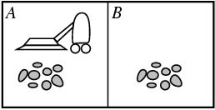
Vacuum World
States: Determined by agent location and dirt location
Initial state: any state possible
Actions: Left, Right, Suck
Transition model: actions have expected effects, except Left from A and Right from B are no-ops, as is Suck when Clean.
Goal test: All squares are clean.

Slide 25
Vacuum World

Slide 26
Buckets
Measure 7 liters of water using a 3-liter, a 5-liter, and a 9-liter buckets.
States: Amount of water in the buckets
Initial State: Empty buckets
Goal: Have 7 liters of water in 9-liter bucket
Actions: fill bucket <x>, empty bucket <x> [to bucket <y>]
Find solution: Sequence of operators that bring you
from current state to the goal state

Slide 27
Real World Problems
Real world is absurdly complex; some abstraction is necessary to allow us to reason on it…
Selecting the correct abstraction and resulting state space is a difficult problem!
Abstract states ⬄ real-world states
Abstract operators ⬄ sequences of real-world actions
(e.g., going from city i to city j costs Lij ⬄ actually drive from city i to j)
Abstract solution ⬄ set of real actions to take in the real world that solve problem

Slide 28
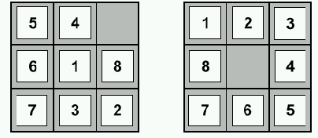
Huge search space, even for toy problems
start state
goal state
8-Puzzle scales up quickly
8-puzzle has 362,880 states
15-puzzle has 10^12 states
24-puzzle has 10^25 states
So, we need a principled way to look for a solution in these huge search spaces…

Slide 29
Search Finding Path from Initial State to Goal
Blind/uninformed search
Search only based on goal, states, operators
Heuristic/informed search
Use additional knowledge about states and/or operators to guide search
Heuristics: Approximate knowledge or rules of thumb
But information need not just be heuristic

Slide 30
From problem space to search tree
Some material in this and following slides is from
http://www.cs.kuleuven.ac.be/~dannyd/FAI/ check it out!
3
A
4
B
4
C
Problem space
S
5
5
G
4
D
E
F
3
2
4
3
S
4
4
A
D
Associated
loop-free
search tree
5
5
2
B
D
A
E
4
5
2
4
5
4
C
E
E
B
B
F
2
4
5
4
4
5
4
4
3
D
F
B
F
C
E
A
C
G
3
4
3
4
G
C
G
F
G
3

Slide 31
Paths in search trees
Denotes:
SA
S
A
Denotes:SDA
D
B
D
A
E
C
E
E
B
B
F
D
F
B
F
C
E
A
C
G
Denotes:
SDEBA
G
C
G
F
G

Slide 32
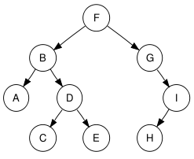
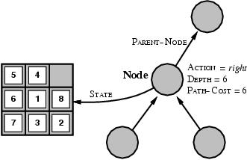
Search Tree Nodes
A node in the search tree is a data structure containing the state plus other data

Slide 33
Search Strategy: Which State to Examine Next?
3
A
4
B
4
C
Problem space
S
5
5
G
4
D
E
F
3
2
4
3
S
4
4
A
D
Associated
loop-free
search tree
5
5
2
B
D
A
E
4
5
2
4
5
4
C
E
E
B
B
F
2
4
5
4
4
4
3
D
F
B
F
A
C
G
3
4
3
G
C
G

Slide 34
Search Strategies
Breadth-First
Depth-First
Uniform Cost
Variants
Iterative deepening
Backward search
Bidirectional search

Slide 35
Breadth-first search
S
A
D
Move downwards, level by level, until goal is reached.
B
D
A
E
C
E
E
B
B
F
D
F
B
F
C
E
A
C
G
G
C
G
F
G

Slide 36
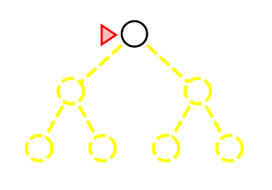
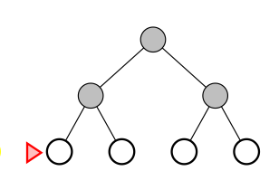
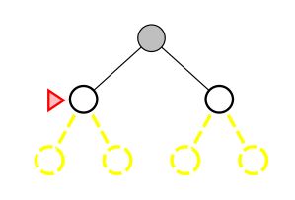
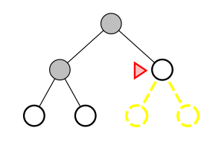
Breadth-First Search
Expand shallowest nodes first
Left to right at any depth

Slide 37
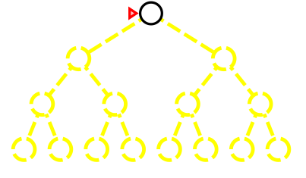
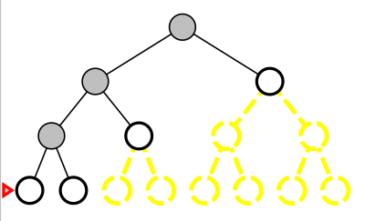
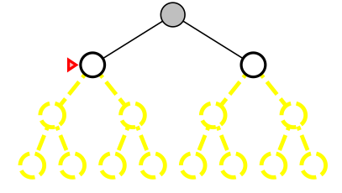
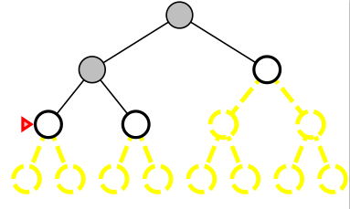
Depth-First Search
Expand deepest nodes first
Left to right at any depth

Slide 38
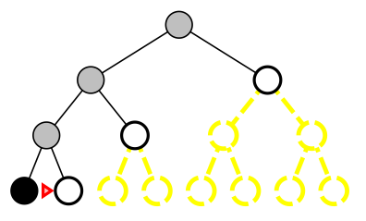
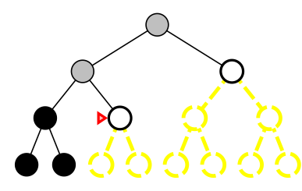
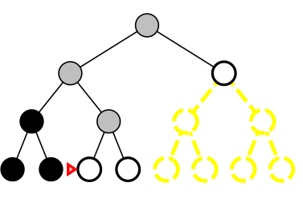
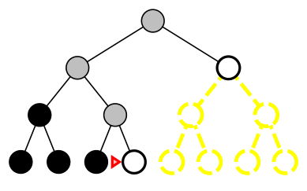
Depth-First Search
Expand deepest nodes first
Left to right at any depth
Backtrack when hit terminal

Slide 39
Generic Tree Search Algorithm
function TREE-SEARCH(problem) return a solution or failure
frontier ← MAKE-QUEUE(MAKE-NODE(problem.INITIAL-STATE))
loop do
if EMPTY?(frontier) then return failure
node ← REMOVE-FIRST(frontier)
if problem.GOAL-TEST applied to node.STATE succeeds
then return SOLUTION(node)
frontier← INSERT-ALL(EXPAND(node, problem), frontier)
The frontier is the set of nodes that have been generated but not yet expanded
Notes:
Removed frontier from function parameters, as doesn’t seem needed

Slide 40
Generic Tree Search Algorithm
function TREE-SEARCH(problem) return a solution or failure
frontier ← MAKE-QUEUE(MAKE-NODE(problem.INITIAL-STATE))
loop do
if EMPTY?(frontier) then return failure
node ← REMOVE-FIRST(frontier)
if problem.GOAL-TEST applied to node.STATE succeeds
then return SOLUTION(node)
frontier← INSERT-ALL(EXPAND(node, problem), frontier)
The frontier is the set of nodes that have been generated but not yet expanded
Usually represented as a queue (a linear data structure)
Queue operations include INSERT, REMOVE-FIRST, MAKE-QUEUE, EMPTY? and INSERT-ALL
Search strategy determined by how insert new nodes into queue!
Notes:
Removed frontier from function parameters, as doesn’t seem needed

Slide 41
Generic Tree Search Algorithm
function TREE-SEARCH(problem) return a solution or failure
frontier ← MAKE-QUEUE(MAKE-NODE(problem.INITIAL-STATE))
loop do
if EMPTY?(frontier) then return failure
node ← REMOVE-FIRST(frontier)
if problem.GOAL-TEST applied to node.STATE succeeds
then return SOLUTION(node)
frontier← INSERT-ALL(EXPAND(node, problem), frontier)
SOLUTION extracts path from PARENT-NODE and STATE links in node(s) back to initial state
Arad
Bucharest
Notes:
Removed frontier from function parameters, as doesn’t seem needed

Slide 42
Queues and Search Strategy
Where INSERT/INSERT-ALL place(s) new elements in queue determines strategy
Always remove elements from the front
Breadth-first search
Places new element(s) at end of queue
First-In-First-Out (FIFO) behavior
Depth-first search
Places new element(s) at the front of the queue
Last-In-First-Out (LIFO) behavior (a Stack)
Can implement recursively rather than iteratively if desired
Random walk places new elements in random places
We will also see see priority queues, where new elements are inserted sorted according to some value (Uniform Cost Search)
Notes:
Will look at recursive depth-first under depth-limited

Slide 43
Expand Function
function EXPAND(node,problem) return a set of nodes
successors ← the empty set
for each <action, result> in problem.SUCCESSOR-FN(node.STATE) do
s ← a new NODE
s.STATE ← result
s.PARENT-NODE ← node
s.ACTION ← action
s.DEPTH ← node.DEPTH+1
add s to successors
return successors
The SUCCESSOR-FN for a problem, when applied to a state, returns a set of two-element vectors
Each vector includes an action that can be applied to the state and the state that results from applying that action
E.g., <P-to-K4, Opening board with KP forward 2>

Slide 44
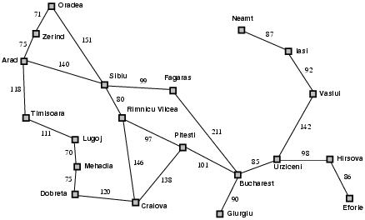
Path Cost (for Optimality)
Cost of reaching goal
During performance, not search
May be an important factor in choosing which goal state or path to goal state to use
Simplest is just length of path
But when explicit costs on links, will be sum of them
Arad→Sibiu→Rimnicu Vilcea→Pitesti→Bucharest = 418

Slide 45
Expand Function (Revised)
function EXPAND(node,problem) return a set of nodes
successors ← the empty set
for each <action, result> in problem.SUCCESSOR-FN(node.STATE) do
s ← a new NODE
s.STATE ← result
s.PARENT-NODE ← node
s.ACTION ← action
s.PATH-COST ← node.PATH-COST + STEP-COST(node,action,s)
s.DEPTH ← node.DEPTH+1
add s to successors
return successors

Slide 46
From Trees to Graphs
So far, we’ve talked about searching in trees…
What if our problem space is a graph?

Slide 47
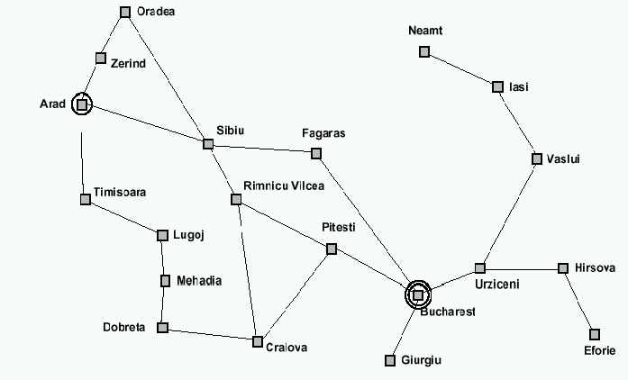
Example: Traveling from Arad To Bucharest

Slide 48
From problem space to search tree
Some material in this and following slides is from
http://www.cs.kuleuven.ac.be/~dannyd/FAI/ check it out!
3
A
4
B
4
C
Problem space
S
5
5
G
4
D
E
F
3
2
4
3
S
4
4
A
D
Associated
loop-free
search tree
5
5
2
B
D
A
E
4
5
2
4
5
4
C
E
E
B
B
F
2
4
5
4
4
5
4
4
3
D
F
B
F
C
E
A
C
G
3
4
3
4
G
C
G
F
G
3

Slide 49
Paths in search trees
Denotes:
SA
S
A
Denotes:SDA
D
B
D
A
E
C
E
E
B
B
F
D
F
B
F
C
E
A
C
G
Denotes:
SDEBA
G
C
G
F
G

Slide 50
Search for route…

Slide 51

General search example

Slide 52
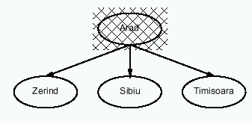
General search example

Slide 53
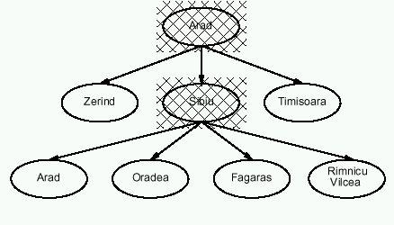
General search example

Slide 54
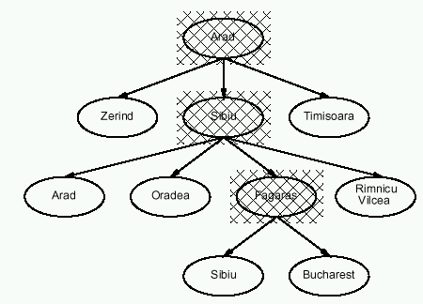
General search example

Slide 55
Graph Search Problems
Tree Search may get stuck when searching graphs:
Breadth first version: may re-visit already visited states
Depth first version: may get stuck in infinite loop

Slide 56
Looping Problems

Slide 57
Modify Tree Search…
function TREE-SEARCH(problem) return a solution or failure
frontier ← MAKE-QUEUE(MAKE-NODE(problem.INITIAL-STATE))
loop do
if EMPTY?(frontier) then return failure
node ← REMOVE-FIRST(frontier)
if problem.GOAL-TEST applied to node.STATE succeeds
then return SOLUTION(node)
frontier← INSERT-ALL(EXPAND(node, problem), frontier)

Slide 58
Graph Search
function GRAPH-SEARCH(problem) return a solution or failure
frontier ← MAKE-QUEUE(MAKE-NODE(problem.INITIAL-STATE))
explored_set ← empty
loop do
if EMPTY?(frontier) then return failure
node ← REMOVE-FIRST(frontier)
if problem.GOAL-TEST applied to node.STATE succeeds
then return SOLUTION(node)
explored_set ← INSERT(node, explored_set) for each new_node in EXPAND(node, problem) do if NOT(MEMBER?(new_node, frontier)) and NOT(MEMBER?(new_node, explored_set))
then frontier ← INSERT(new_node, frontier)

Slide 59
Explored_Set Issues
Maintaining and checking explored_set adds cost
Required for depth-first search to avoid infinite loops
Not strictly required in breadth-first search (if there is a solution)
But worth it if many loops in search space
Needed to detect that there is no solution

Slide 60
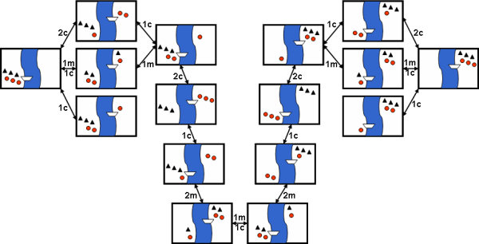
Missionaries and Cannibals
Did you find that there was much search involved in finding a solution?
Why do people have a hard time solving this problem?
Notes:
There are a number of constraints on solutions to this problem, for example, the boat only holds one or two people, you can never have more cannibals than missionaries on either side of the river, etc. Constraints are generally thought of as making it harder to solve a problem, but could they make it easier? How?

Slide 61
Evaluating Search Performance
Search performance is measured in four ways:
Completeness: Does it always find a solution if one exists?
Optimality: Does it always find least cost path to a solution?
Time Complexity: Number of nodes generated
Space Complexity: Number of nodes kept in memory
Time and space complexity are assessed in terms of:
b - maximum branching factor of the search tree (2 in figure)
d - depth of the least-cost solution (2 in figure)
m - maximum depth of the state space (may be ∞) (4) in fig

Slide 62
Complexity
Why worry about complexity of algorithms?
because a problem may be solvable in principle but may take too long to solve in practice

Slide 63
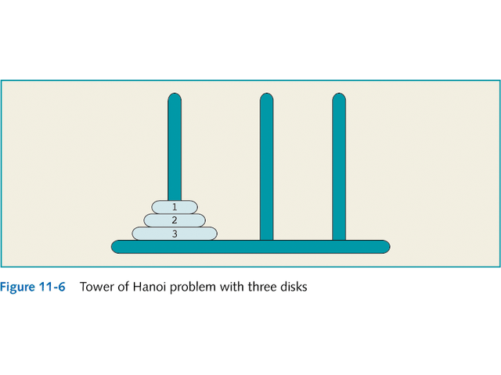
Complexity: Tower of Hanoi

Slide 64
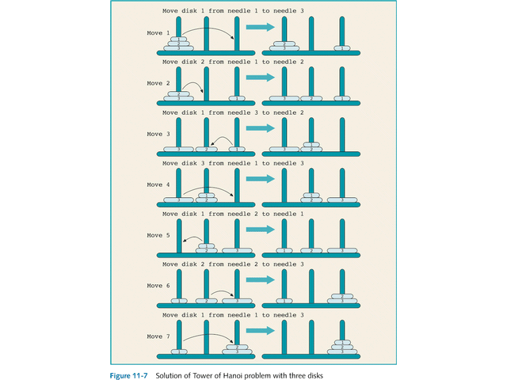
Complexity: Tower of Hanoi

Slide 65
Complexity: Tower of Hanoi
3-disk problem: 2³ - 1 = 7 moves
64-disk problem: 2⁶⁴ - 1.
2¹⁰ = 1024 ≈ 1000 = 10³,
2⁶⁴ = 2⁴ * 2⁶⁰ ≈ 2⁴ * 10¹⁸ = 1.6 * 10¹⁹
One year ≈ 3.2 * 10⁷ seconds

Slide 66
Complexity
Why worry about complexity of algorithms?
because a problem may be solvable in principle but may take too long to solve in practice
How can we evaluate the complexity of algorithms?
through asymptotic analysis, i.e., estimate time (or number of operations) necessary to solve an instance of size n of a problem when n tends towards infinity
See AIMA, Appendix A.

Slide 67
Complexity: O() measures
How can we represent the complexity of an algorithm?
Given: Problem input (or instance) size: n
Number of operations to solve problem: f(n)
If, for a given function g(n), we have:
then f is dominated by g

Slide 68
Example
f(n) = x⁴ + 3x³ + 2x²
f(n) is O(x⁴) because other terms are negligible with respect to x⁴
What is the Big O() for the Tower of Hanoi problem?

Slide 69
Visualizing Orders of Growth
O(1): Constant growth
O(log(n)): Logarithmic growth
O(n): Linear growth
O(n^{k}): Polynomial growth, where k is a constant
O(2^{n}): Exponential growth
Try plot them out yourself:
https://www.desmos.com/calculator
www.wolframalpha.com

Slide 70
Evaluating Search Performance
Search performance is measured in four ways:
Completeness: Does it always find a solution if one exists?
Optimality: Does it always find least cost path to a solution?
Time Complexity: Number of nodes generated
Space Complexity: Number of nodes kept in memory

Slide 71
Evaluating Breadth-First Search
Completeness
When b is finite
Optimality
When constant step cost
Time Complexity (Worst Case)
b+b²+b³+…+b^{d}+b^{d+1} = O(b^{d+1})
Can reduce to O(b^{d}) if check for goal when node generated rather than when expanded (Figure 3.11 in text shows BFS that does this)
Space Complexity
Same as time complexity
Notes:
Book version 3 does check when generated

Slide 72
Breadth First Search (b=10)
Depth | Nodes | Time | Memory
2 | 110 | 110 μs | 107 KB
4 | 11,110 | 11 ms | 10.6 MB
6 | 10⁶ | 1.1 sec | 1 GB
8 | 10⁸ | 2 min | 103 GB
10 | 10¹⁰ | 3 hrs | 10 TB
12 | 10¹² | 13 days | 1 PB
14 | 10¹⁴ | 3.5 yrs | 99 PB
16 | 10¹⁶ | 3.5 cen | 10 EB
Assuming 1 μs and 1000 B per node
Notes:
Memory a bigger problem than time, but both quickly become problems.

Slide 73
Evaluating Depth-First Search
Completeness
Complete in finite spaces if use graph search version
Optimality
No (both versions)
Time Complexity
Nodes in Tree: b+b²+…+b^{m} = O(b^{m})
Roughly search half of tree: (b^{m})/2 = O(b^{m})
Space Complexity
b*m if generate all children as move down
m if generate only one child at a time

Slide 74
Does completeness of depth-first search depend on finiteness of problem space (b^{m}) or only on finiteness of m?
On finiteness of space, because if b is infinite, can still get stuck moving forever down one fruitless branch when solution is elsewhere
Infinite branching subtree
Goal

Slide 75
Comparison
Breadth-first has an advantage on completeness – if infinite space – optimality, and time complexity (particularly if m>>d)
Depth-first has a big advantage on space complexity (m vs b^{d+1})

Slide 76
Variations and Enhancements
Breadth-first ➔ Uniform-cost search
Yield optimality in presence of general path costs
Depth-first ➔ Iterative-deepening search
Yield completeness even when space is infinite
Yield same optimality properties as breadth-first
Reduce time complexity when m>d
Backward search
(Possibly) Reduce branching factor
Bidirectional search
Reduce search depth

Slide 77
Uniform Cost Search
Expand node with lowest path cost first
Requires a priority queue
5
12
14
17
8

Slide 78
Uniform Cost Search
Expand node with lowest cost path first
Requires a priority queue
5
8
12
14
17

Slide 79
Uniform Cost Example
10
5
5,10
10,12,13
11,12,13,13
1
3
7
8

Slide 80
Uniform Cost (Key mods)
Similar to Breadth First Search BUT:
Queue order by path cost
Goal test applied when node selected for expansion rather than when first generated otherwise may miss optimal path
Test added in case better path found to node on frontier

Slide 81
Uniform Cost Search

Slide 82
Search for route…

Slide 83
Uniform Cost Search in action
Expand Sibiu

Slide 84
Uniform Cost Search in action
Lowest cost is Rimnicu Vilcea; expand it next

Slide 85
Uniform Cost Search in action
Now lowest cost is Fagaras; expand it

Slide 86
Uniform Cost Search in action
Bucharest is goal, but if we stop now the path through Fagaras is not optimal

Slide 87
Uniform Cost Search in action
Expand Pitesti, substitute better path in frontier

Slide 88
Another example
Uniform-cost search not optimal if it is terminated when some node in the queue has goal state.
1
S
1
5
A
5
1
C
2
B
5
Uniform cost returns the path with cost 102 (if any goal node is considered a solution), while there is a path with cost 25.
D
10
5
100
E
15
5
F
20
G
5

Slide 89
Properties of uniform-cost search
Completeness: Yes, if steps have non-zero costs
Time & Space complexity
Not easily characterized in terms of b, d & m since search guided by path costs
Assume C* is cost of optimal solution & every action costs at least ε, then worst case time & space is given by:
Can be much greater than b^{d} since can get stuck on lots of low-cost insignificant steps
Optimality:
Yes, as long as path cost never decreases

Slide 90
Depth-limited search
Is a depth-first search with depth limit l
Implementation: Nodes at depth l have no successors.
Complete: if cutoff chosen appropriately then it is guaranteed to find a solution.
Optimal: it does not guarantee to find the least-cost solution

Slide 91
Iterative deepening search
Function Iterative-deepening-Search(problem) returns a solution,
or failure
for depth = 0 to ∞ do
result ← Depth-Limited-Search(problem, depth)
if result succeeds then return result
end
return failure
Combines the best of breadth-first and depth-first search strategies.
Completeness: Yes,
Time complexity: O(b ^{d})
Space complexity: O(bd)
Optimality: Yes, if step cost = 1

Slide 92
Search for route…

Slide 93
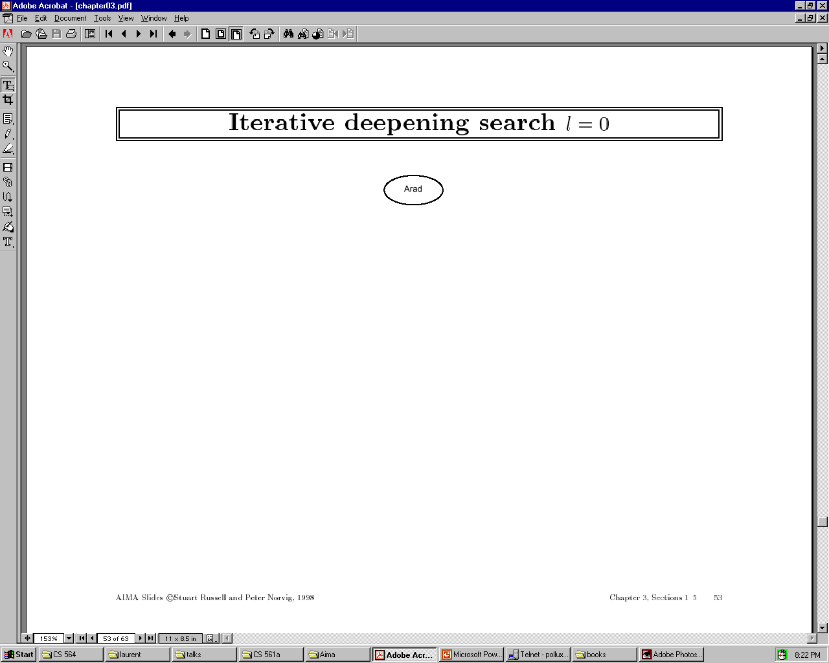

Slide 94


Slide 95
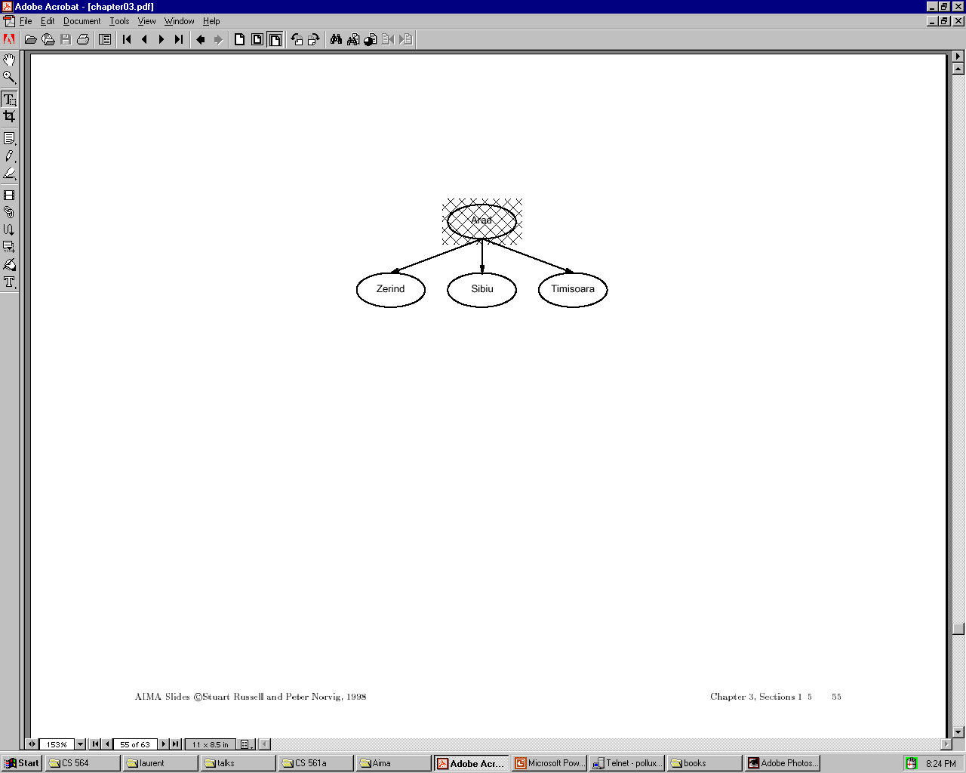

Slide 96


Slide 97


Slide 98
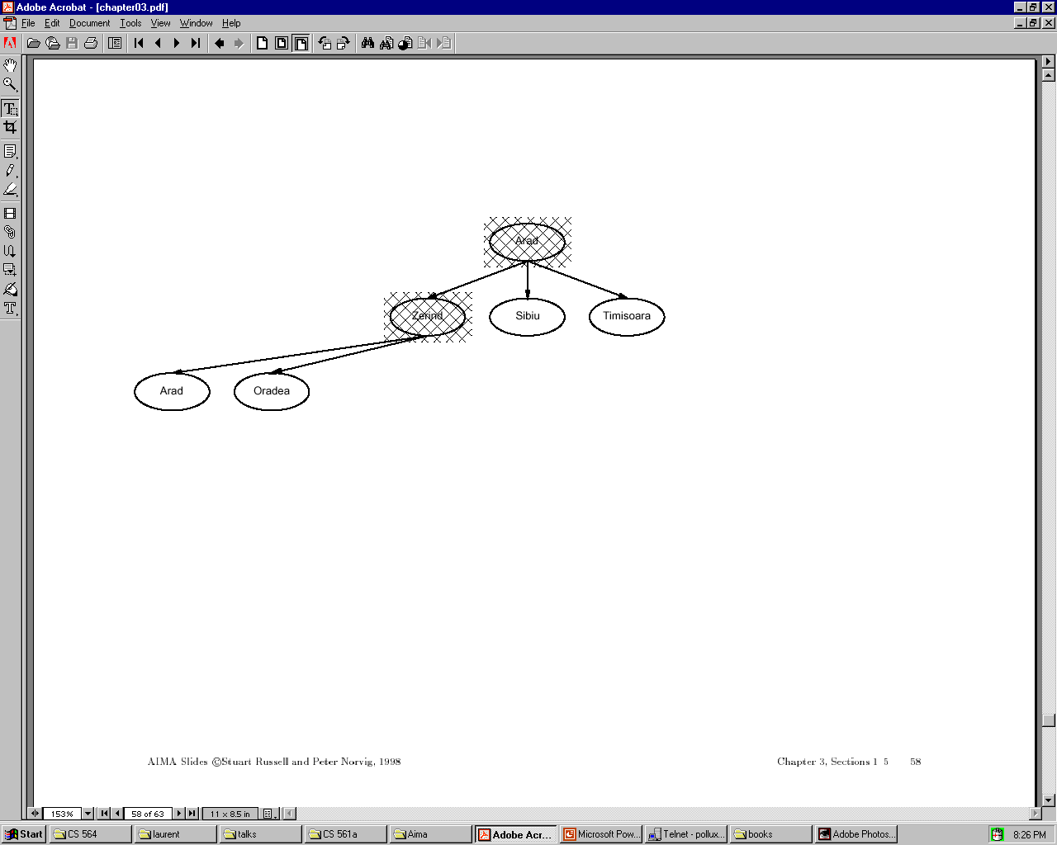

Slide 99
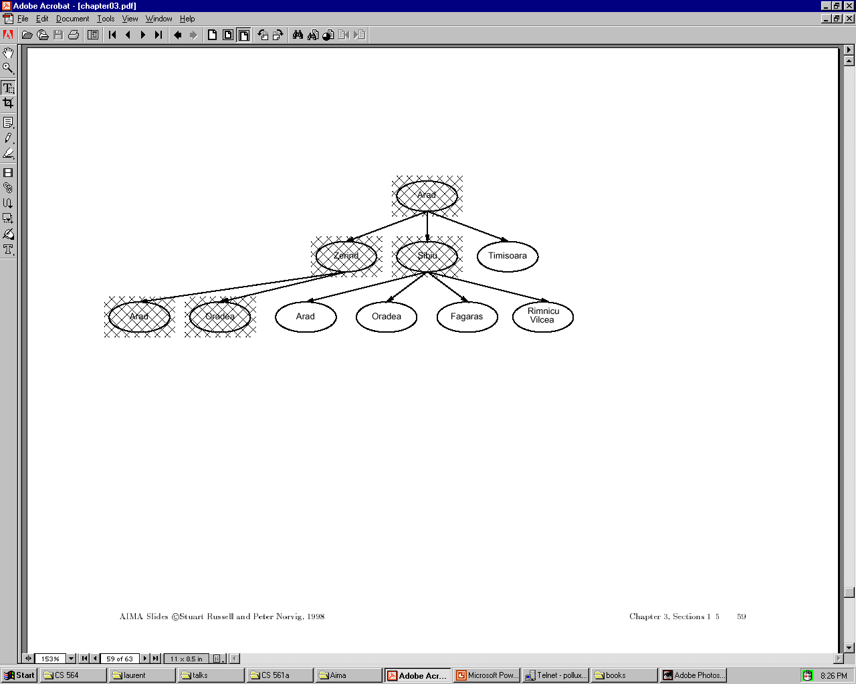

Slide 100
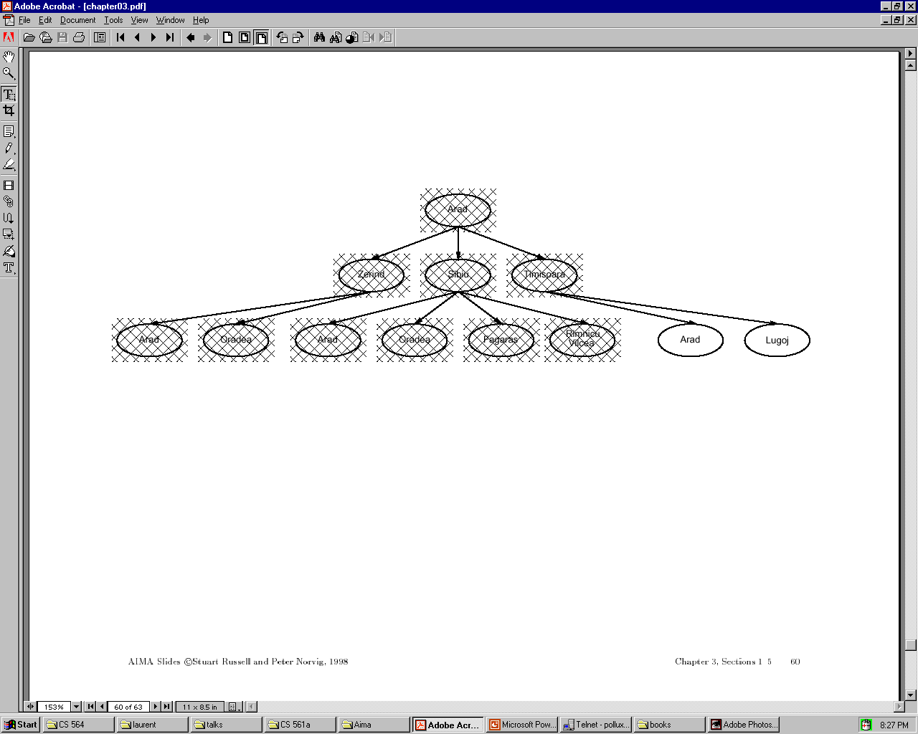

Slide 101
Iterative deepening complexity
Iterative deepening search may seem wasteful because so many states are expanded multiple times.
In practice, however, the overhead of these multiple expansions is small, because most of the nodes are towards leaves (bottom) of the search tree:
thus, the nodes that are evaluated several times (towards top of tree) are in relatively small number.

Slide 102
Iterative deepening complexity
In iterative deepening, nodes at bottom level are expanded once, level above twice, etc. up to root (expanded d+1 times) so total number of expansions is:
(d+1)1 + (d)b + (d-1)b^2 + … + 3b^(d-2) + 2b^(d-1) + 1b^d = O(b^d)
In general, iterative deepening is preferred to depth-first or breadth-first when search space large and depth of solution not known.

Slide 103
Bidirectional search
Both search forward from initial state, and backwards from goal.
Stop when the two searches meet in the middle.
Problem: how do we search backwards from goal??
predecessor of node n = all nodes that have n as successor
this may not always be easy to compute!
if several goal states, apply predecessor function to them just as we applied successor
Start
Goal

Slide 104
Bidirectional search
Problem: how do we search backwards from goal?? (cont.)
…
for bidirectional search to work well, there must be an efficient way to check whether a given node belongs to the other search tree.
select a given search algorithm for each half.
Start
Goal

Slide 105
Bidirectional search
1. QUEUE1 <-- paths only containing the root;
QUEUE2 <-- paths only containing the goal;
2. WHILE both QUEUEs are not empty
AND QUEUE1 and QUEUE2 do NOT share a state
DO remove their first paths;
create their new paths (to all children);
reject their new paths with loops;
add their new paths to back;
3. IF QUEUE1 and QUEUE2 share a state
THEN success;
ELSE failure;

Slide 106
Bidirectional search
Completeness: Yes,
Time complexity: 2*O(b ^{d/2}) = O(b ^{d/2})
Space complexity: O(b ^{m/2})
Optimality: Yes
To avoid one by one comparison, we need a hash table of size O(b ^{m/2})
If hash table is used, the cost of comparison is O(1)

Slide 107
Bidirectional Search
Initial State
Final State
d / 2
d

Slide 108
Bidirectional search
Bidirectional search merits:
Big difference for problems with branching factor b in both directions
A solution of length d will be found in O(2b^{d/2}) = O(b^{d/2})
For b = 10 and d = 6, only 2,222 nodes are needed instead of 1,111,111 for breadth-first search

Slide 109
Bidirectional search
Bidirectional search issues
Predecessors of a node need to be generated
Difficult when operators are not reversible
What to do if there is no explicit list of goal states?
For each node: check if it appeared in the other search
Needs a hash table of O(b^{d/2})
What is the best search strategy for the two searches?

Slide 110
Comparing uninformed search strategies
Criterion Breadth- Uniform Depth- Depth- Iterative Bidirectional
first cost first limited deepening (if applicable)
Time b^d b^d b^m b^l b^d b^(d/2)
Space b^d b^d bm bl bd b^(d/2)
Optimal? Yes Yes No No Yes Yes
Complete? Yes Yes No Yes, Yes Yes
if l≥d
b – max branching factor of the search tree
d – depth of the least-cost solution
m – max depth of the state-space (may be infinity)
l – depth cutoff

Slide 111
Search Graph
Notes:
a)DFS G1 (2%) _____ S­A­E­G1 ( 8%) [No partial credit]
b)UCS G3(2%) _____ S­C­D­B­G3( 8%) [No partial credit]
c)A* G3(2%) _____ S­B­C­D­G3 OR S­B­C­D­B­G3 (8%) [No partial credit]

Slide 112
Next Week
Beyond Classical Search (Chapter 4)
Adversarial Search (Games) (Chapter 5)
Constraint Satisfaction Problems (Chapter 6)
Practice Exercises:
Chapter 4: # 4.1
Chapter 6: # 6.1, 6.5

